Slide 1
Key Stage 2 SATs
Information for parents and carers
Notes:
LMc

Slide 2
What are the SATs?
SATs is a term people use to refer to End of Key Stage 2 Assessments;
It lasts for four days beginning on the Monday AFTER the first May bank holiday
Children will sit the following SATs papers:
- Grammar, Punctuation and Spelling (Paper 1) –Monday
- Grammar, Punctuation and Spelling (Paper 2) – Monday
- Reading – Tuesday
- Maths Paper 1 (Arithmetic) –Wednesday
- Maths Paper 2 (Reasoning) – Wednesday
- Maths Paper 3 (Reasoning) – Thursday
Writing is assessed using evidence collected by your child’s English teacher throughout Year 6, so there is no Year 6 SATs writing test.
Notes:
LMc

Slide 3
When do SATs happen?
The tests will take place during normal school hours, under exam conditions;
Children are not allowed to talk to each other from the moment the assessments are handed out until they are collected after the test has ended;
Afterwards, the completed papers are sent away to be marked externally;
The children’s results are sent back to school at some point in July;
The standard timings of tests differ but last no more than 60 minutes:
- Grammar, Punctuation and Spelling (Paper 1) – 45 minutes;
- Grammar, Punctuation and Spelling (Paper 2) – 15 minutes;
- Reading – 60 minutes;
- Maths Paper 1 (Arithmetic) – 30 minutes;
- Maths Paper 2 (Reasoning) – 40 minutes;
- Maths Paper 3 (Reasoning) – 40 minutes.
Notes:
LMc

Slide 4
Special arrangements
Children with additional needs, who have similar provision in their day-to-day learning at school, may be allotted specific arrangements, including:
Additional (extra) time;
Tests being opened early to be modified;
An adult to read for them;
An adult to scribe (write) for them;
Written or spoken translations of the mathematics reasoning papers;
The use of prompts or rest breaks;
Arrangements for children who are ill or injured at the time of the tests.
Notes:
LMc

Slide 5
What results are reported?
Once marked, the tests will be given the following scores:
A raw score (the total number of marks achieved for each paper);
A scaled score (which is explained below);
A judgement of whether the National Standard has been met.
After marking each test, the external markers will convert each raw score into a scaled score to show whether each child is working below, at or above the national standard.
When the scaled score is given, it is given in a range from 80 to 120.
A scaled score of 100 or more is meeting the national standard.
There are no separate tests for higher achieving pupils; however, a scaled score close to 120 would show that a child is working above the national standard.
Notes:
LMc

Slide 6
Writing
No longer a SATs test
Teacher assessment judgement
Portfolio of a minimum of 6 independent pieces
Range of text types
Evidence of GPS knowledge used
Evidence of reading experience within
Current English KOs for skills and knowledge

Slide 7
Mock SATs week
You will be advised of the dates of Mock SATS week
8.25am
Meet in the hall to register
Small snack and drink
Office care calls home
Toilets
Test reminders
Move to testing spaces
10.40am Break time
11am Normal lessons

Slide 8
Grammar, punctuation and spelling (GPS)
Grammar, Punctuation and Spelling is made up of two papers which will take place on Monday 11th May:
Paper 1 is the longer paper lasting 45 minutes, children will be tested on grammar, punctuation and spelling generally;
Paper 2 is a shorter paper lasting 15 minutes, where children will be tested on spelling only – they are asked to fill in a blank within a sentence, attempting to spell out the spelling word in context correctly.
Notes:
CB

Slide 9
GPS paper 1
Grammar, Punctuation and Spelling (Paper 1) focuses on the following areas:
- Grammatical terms/word classes;
- Functions of sentences;
- Combining words, phrases and clauses;
- Verb forms, tenses and consistency;
- Punctuation;
- Vocabulary;
- Standard English and formality.
Grammar, Punctuation and Spelling (Paper 1) requires a range of answer types such as circling missing capital letters, multiple choice questions, one-word answers, but does not require longer formal answers.
Notes:
CB

Slide 10
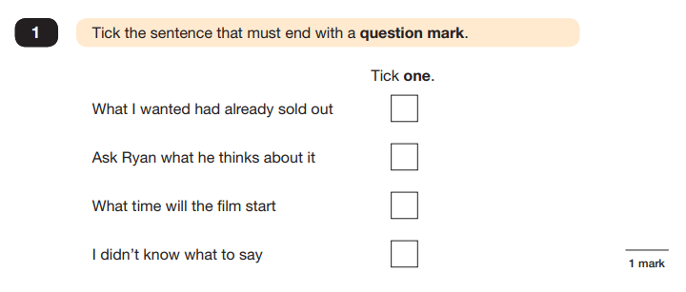
Examples….
Notes:
CB

Slide 11
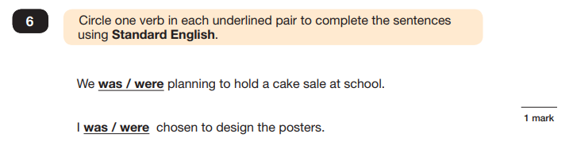
Notes:
CB

Slide 12
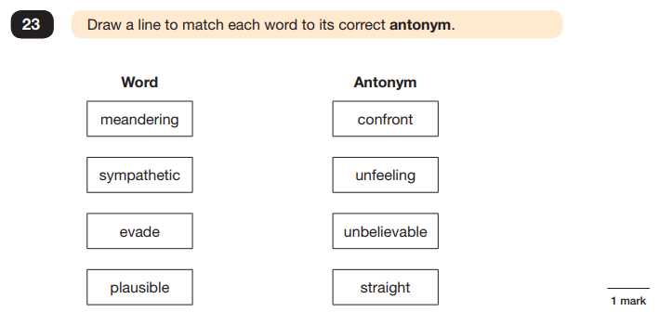
Notes:
CB

Slide 13
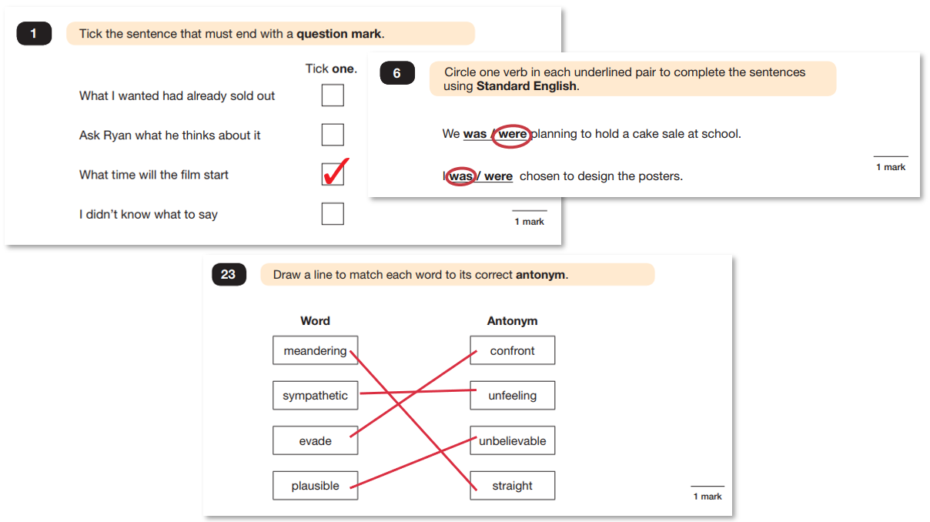
Notes:
CB

Slide 14
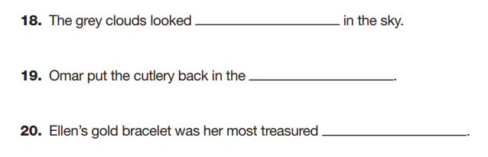
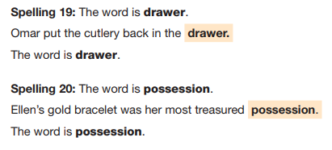
GPS paper 2 - spelling
Notes:
CB

Slide 15
Reading
The assessment has been designed to measure whether children’s comprehension of age-appropriate reading material meets the national standard.
It a standard timing of 60 minutes, including reading the texts and answering questions. There are three different set texts for the children to read, which could be any combination of non-fiction, fiction and/or poetry.
Notes:
CB

Slide 16
The Reading paper focuses on the following areas known as Content Domains:
2a) give/explain the meaning of words in context;
2b) retrieve and record information/identify key details from fiction and non-fiction;
2c) summarise main ideas from more than one paragraph;
2d) make inferences from the text/explain and justify inferences with evidence from the text;
2e) predict what might happen from details stated and implied;
2f) identify/explain how information/content is related and contributes to meaning as a whole;
2g) identify/explain how meaning is enhanced through choice of words and phrases;
2h) make comparisons within the text.
Notes:
CB

Slide 17
The Year 6 Reading SATs paper requires a range of answering styles, including responding to multiple choice questions, one-word answers, and multiple mark questions which require more formal paragraph-length answers.
Notes:
CB

Slide 18
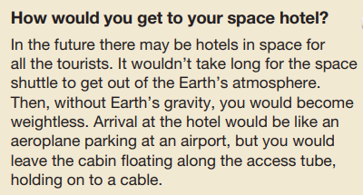
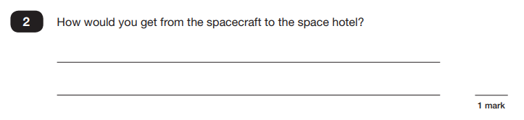
Examples…
Notes:
CB

Slide 19
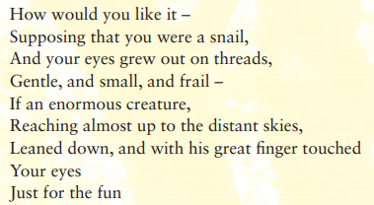
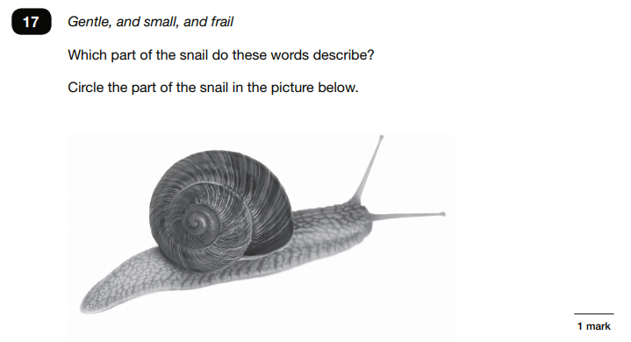
Notes:
CB

Slide 20
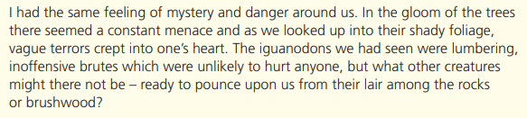
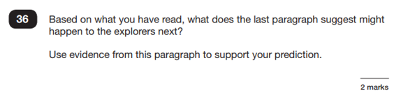
Notes:
CB

Slide 21
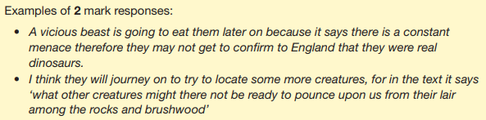
Notes:
CB

Slide 22
Hints and tips…
Since the current testing format for the Year 6 SATs began in 2016, there has been a tendency for the number of marks to go in favour towards three particular types of content domain / questions.
For example, in previous papers
20% of marks could be gained by answering questions where children had to give/explain the meaning of words in context (Content Domain 2a);
Over a quarter of marks could be gained by answering questions where children had to retrieve/record information or details from the texts (2b);
Almost half of the marks were allotted to questions requiring children to make inferences from a text, justifying inferences with text evidence (2d).
Notes:
CB

Slide 23
So, when reading with your child at home, try asking questions like:
Find a word in this paragraph that is closest in meaning to ‘provide word –
e.g. annoyed’ (2a);
In what year did ‘provide fact – e.g. the French authorities make it illegal for people to swim from France to England’? (2b);
In the last paragraph, X does not want to Y.
Give two reasons why X does not want Y. (2d)
Notes:
CB

Slide 24

Online computer quizzes on the books read
ZPD Range 0.1+
Reading age
Words read
Develops vocabulary knowledge
Notes:
CB

Slide 25
Termly reviews:
ZPD = reading range
Targets = point per book.
Students reading for 20 minutes a day, within their ZPD, will meet their target.
Accuracy = 85% aim minimum
Key skill for SATs revision.
Quality reading not quantity.
Notes:
CB

Slide 26
Maths 1 - arithmetic
Standard timing of 30 minutes and is worth a total of 40 marks.
It covers the four operations (division, multiplication, addition, subtraction and mixed operation calculations requiring BODMAS), as well as number properties, calculating percentages of amounts, calculations using decimals, and calculations using fractions.
Notes:
RA

Slide 27
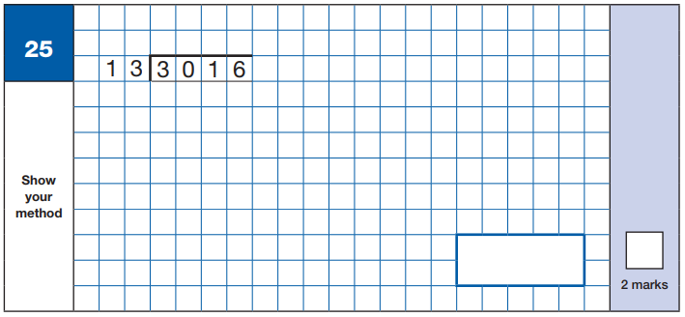
Example questions
Notes:
RA

Slide 28
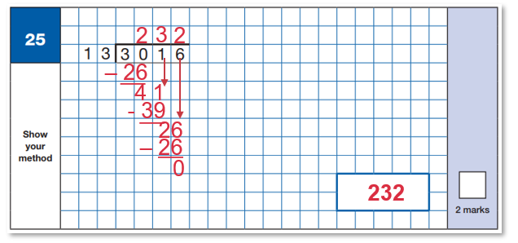
1 – 13
2 – 26
3 – 39
4 – 52
5 – 65
6 – 78
7 – 91
8 – 104
9 - 117
10 - 130
Notes:
RA

Slide 29

Notes:
RA

Slide 30
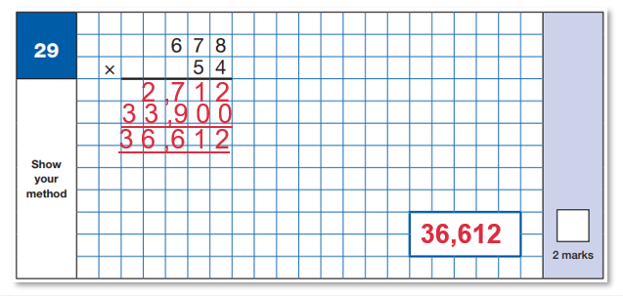
Notes:
RA

Slide 31
Maths 2 and 3 - reasoning
Both have standard timings of 40 minutes and are worth 35 marks each.
Paper 2 and 3 requires children to demonstrate their mathematical knowledge and skills, as well as their ability to solve problems and their mathematical reasoning.
Questions focus on the following Mathematical topic areas:
- Number and place value– including Roman Numerals;
- Addition, subtraction, multiplication and division (calculations);
- Geometry – properties of shapes;
- Geometry – position and direction;
- Statistics;
- Measurement – including length, perimeter, mass (weight), volume, time and money;
- Algebra;
- Ratio and proportion;
- Fractions, decimals and percentages.
The questions get harder throughout the paper.
It is not unusual for a child to be unable to complete the entire paper in time
Notes:
RA

Slide 32
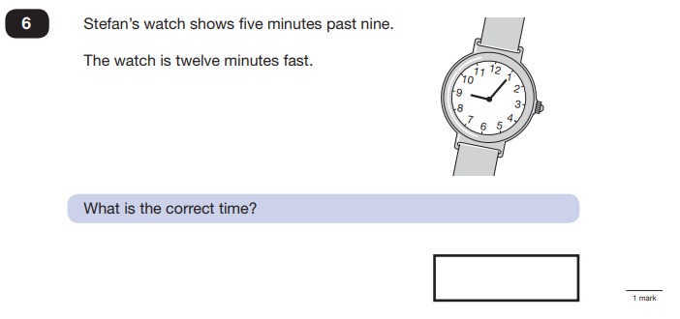
Example questions…
Notes:
RA

Slide 33
8.53
Notes:
RA

Slide 34
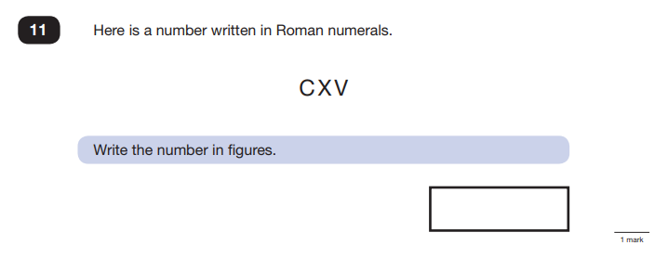
Notes:
RA

Slide 35
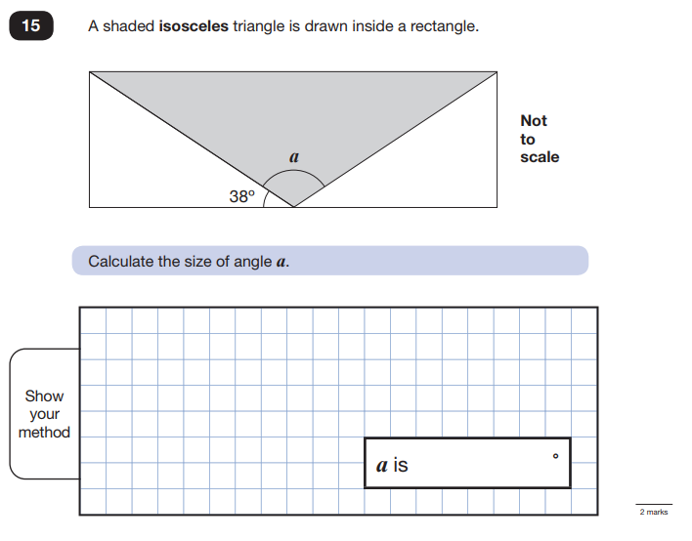
Notes:
RA

Slide 36
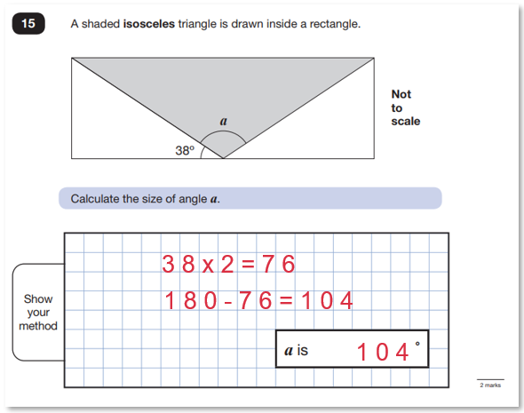
Notes:
RA

Slide 37
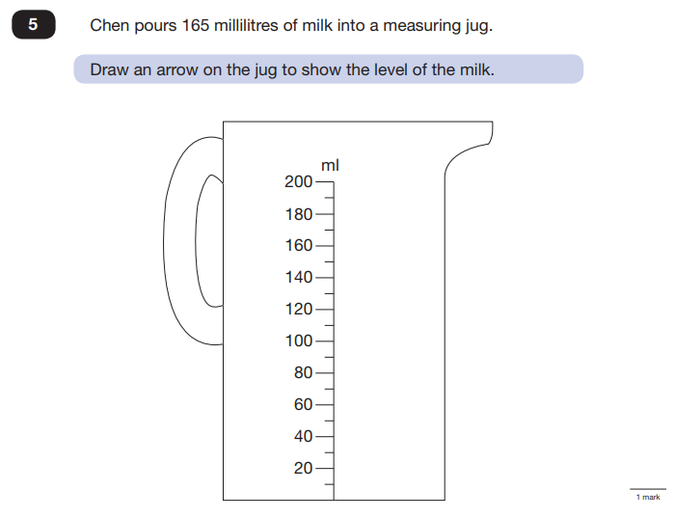
Notes:
RA

Slide 38
Notes:
RA

Slide 39
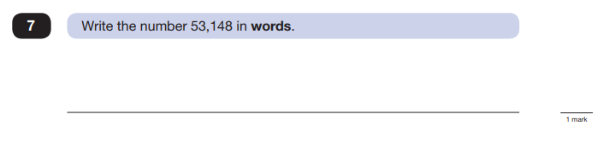
Notes:
RA

Slide 40
Fifty-three thousand, one hundred and forty-eight
Notes:
RA

Slide 41
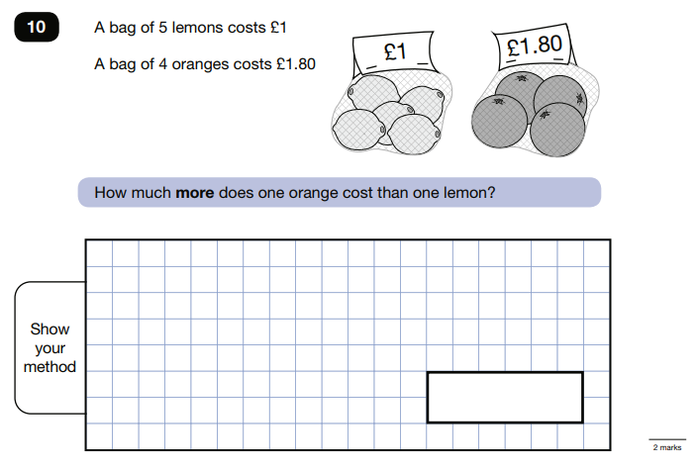
Notes:
RA

Slide 42
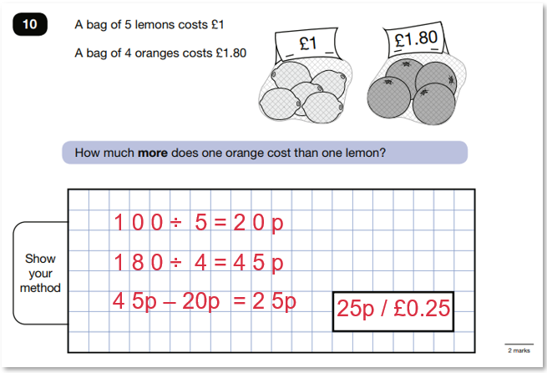
Notes:
RA

Slide 43

Extra support for all
Very detailed, can be overwhelming, progress results
PiXL lessons – weekly
Small group interventions
Small group weekly IDL interventions
Small group McGrawhill's comprehension interventions
House reading competitions
Notes:
RA

Slide 44
How can I support my child?
Firstly, a positive attitude goes a long way – so as much encouragement and support as possible (but we don’t need to tell you that)!
Some further tips:
Direct any questions or concerns you have about SATs to your child’s teacher, rather than worry your child with them;
Give your child opportunities to go outside and avoid overuse of screens - this can apply to leisure pursuits as well as how they study;
Try to provide a quiet corner of the house for homework and study, that’s as free from distractions as possible;
Encourage your child to talk to their teacher or another adult they trust if they express persisting anxieties about SATs. Remember that a small amount of anxiety is normal and not harmful;
If your child is unwilling to talk to their teacher, talk to them yourself;
Plan something nice and fun for the weekends before and after SATs – this will help your child start the week well and also give them something to look forward to;
Ensure your child is eating and drinking well, and getting a suitable amount of sleep.
DO NOT USE PAST PAPERS – if your child has a tutor,
insist they do not use them too – we will be using them!
Notes:
LMc

Slide 45
Create a revision timetable that works for you and your child – for some children and families, a couple of 10 – 20 minute activities a day works best; for others, a longer study session on a Saturday or Sunday might be better.
Keep it light – practice key skills like times tables and practice mental maths in real world scenarios, like adding up prices in the shops, working out discount deals, and asking questions like, “If there are 1,300 grams of flour in this pack, what is that in kilograms?”
Notes:
LMc

Slide 46
Remember about SATS….
SATs focus on what they know about Maths and English
They won’t reflect how talented they are at Science, Geography, Art or PE, and they certainly won’t highlight positive personal characteristics such as kindness and integrity.
SATs results don’t always tell the whole story
The results will say they DID or DIDN’T meet a certain standard, but not necessarily by what margin. Additionally, the thresholds tend to change each year according to overall national performance, so what was classed as ‘did meet the expected standard’ in 2022 may have been considered a ‘did not’ in 2023. We can provide you with more detailed feedback, so don’t let your child see SATs as a simple case of ‘pass’ or ‘fail’.
SATs last for one week
In reality it’s just one or two papers lasting 30-60 minutes each day. You can’t emphasise enough the importance of keeping that in perspective
Notes:
LMc

Slide 47
What should I do if I’m worried about my child?
It would be unnatural for SATs not to induce a certain degree of worry or anxiety but there is, of course, a tipping point.
SATs should not:
affect a child’s appetite;
affect a child’s ability to sleep;
alter a child’s personality;
induce panic, tears or disengagement from lessons;
be a reason not to attend school.
If any of the above are evident, then SATs may be causing an excessive degree of anxiety, and your child may benefit from additional support. This isn’t about removing the reality of SATs, but rather equipping your 10 or 11 year old child
to cope with the situation and be stronger for it.
Notes:
LMc

Slide 48
Steps to take….
Talk to us!
Work with us so everyone concerned can be offering the support that’s needed.
Spend time with your child
Try to understand what aspect of SATs concerns them most. Is it the worry of ‘failing’? Is it the worry of getting stuck on a paper? If your child can pinpoint what’s bothering them most, you can take specific steps to help reassure them.
Try not to project your own anxieties or views on the SATs
If you don’t believe in SATs, or do not think your child should be doing them, then neither will they.
Confront any media coverage
Show clippings if there’s been anything negative and ask them to talk about what they’re seen and how they feel. Reinforce the reality.
Encourage your child to talk to their teacher
SATs are obviously linked to school, so don’t be surprised if they favour the reassurance of teachers above family members.
Notes:
LMc

Slide 49
Advice for Year 6 students
Listen to what your teachers say;
Your teachers are cheering you on and want you to do your best;
Make sure you get plenty of sleep and stay well fed – sleep and food help keep the brain moving;
Read the questions carefully. This can help to avoid any silly mistakes!
Don’t worry if there’s something you can’t answer. Take a deep breath! You can always move on and go back later but it’s better to write something rather than nothing;
Keep in mind year 6 SATs are just one week of your entire life!

Slide 50
‘Stay focused in class so you don’t
have loads of extra study at home!’
- Year 7 pupil’s advice
Notes:
LMc

Slide 51
Useful contacts
Head of English
Mrs Baldwin – cbaldwin@blackminster.worcs.sch.uk
Head of Maths
Mrs Adkins – radkins@blackminster.worcs.sch.uk
SENCO
Miss Lewis – mlewis@blackminster.worcs.sch.uk
Headteacher
Ms McQuone – lmcquone@blackminster.worcs.sch.uk

